Slide 1
Performance Evaluation of Lock-free Data Structures on GPUs http://www.cse.iitk.ac.in/~mainakc/lockfree.html
Prabhakar Misra and Mainak Chaudhuri
Indian Institute of Technology, Kanpur

Slide 2
Sketch
Talk in one slide
Result highlights
Related work
Lock-free data structures
CUDA implementation
Evaluation methodology
Empirical results
Summary

Slide 3
Sketch
Talk in one slide
Result highlights
Related work
Lock-free data structures
CUDA implementation
Evaluation methodology
Empirical results
Summary

Slide 4
Talk in One Slide
Locks are expensive in GPUs
Thousands of threads cause high contention
Lock-free data structures offer a possible way to implement irregular computations on GPUs
Support for dynamically changing pointer-linked data structures is important in many applications
Large body of existing research on lock-free data structures for traditional multiprocessors
This is the first detailed study to explore lock-free linear lists, hash tables, skip lists, and priority queues on CUDA-enabled GPUs

Slide 5
Result highlights
Significant speedup on Tesla C2070 (Fermi GF100) over 24-core server execution
Maximum speedup
7.4x for linear lists
11.3x for hash tables
30.7x for skip list
30.8x for priority queue
Lock-free hash table shows best scalability for a wide range of operation mixes and key ranges
Throughput ranges from 20.8 MOPS to 98.9 MOPS

Slide 6
Sketch
Talk in one slide
Result highlights
Related work
Lock-free data structures
CUDA implementation
Evaluation methodology
Empirical results
Summary

Slide 7
Related work
Our lock-free linear list implementation follows a variation of the Harris-Michael construction
Our hash table implementation leverages the linear list implementation
Our lock-free skip list construction is due to Herlihy, Lev, and Shavit
We follow the construction due to Lotan and Shavit for our lock-free priority queue implementation
More related works are discussed in the paper

Slide 8
Sketch
Talk in one slide
Result highlights
Related work
Lock-free data structures
CUDA implementation
Evaluation methodology
Empirical results
Summary

Slide 9
Lock-free data structures
Linear lists, hash tables, skip lists, priority queues
Important computation building blocks
We implement a set using these data structures
Lock-free and wait-free operations on the set
Lock-free operation: infinitely often some instance of this operation finishes in finite number of steps
Wait-free operation: every instance of this operation finishes in finite number of steps
Correctness criteria: linearizable (except priority queue, which is quiescently consistent)
See paper for definition

Slide 10
Lock-free linear list
Implemented using a sorted singly linked list
Supported ops: add, delete, search
Add(x) returns 0 if x is already in the set; otherwise adds x at sorted position and returns 1
Delete(x) returns 0 if x is not in the set; otherwise removes x from the set and returns 1
Search(x) returns 0 or 1 if x is not found or found in the set
Add and delete are lock-free
Search is wait-free (just walks the list)
Delete only logically deletes a node by marking it
Subsequent add and delete operations physically remove the logically deleted nodes

Slide 11
Lock-free linear list: add(x)
CAS on Mark+next
<x
<x
>=x
Mark+next (32 bits)
x
The Mark bit is the least significant bit of the aligned
32-bit next field
Needed for logical deletion

Slide 12
Lock-free linear list: Physical delete
CAS on Mark+next
Mark+next (32 bits)
Delete(x) logically marks a node. Subsequent add or delete physically deletes it when walking the list.

Slide 13
Lock-free hash table
Leverages lock-free linear list construction
Implemented as a single linear list
An array of pointers stores the starting point (head node) of each bucket
The head node of each bucket stores a special key
Add, delete, and search operations on a bucket start at the head node of that bucket
Number of buckets is constant and fixed at the time of CUDA kernel launch
Supports the same three operations as lock-free linear list

Slide 14
Lock-free hash table
Delete(22): 22 mod 4 = 2
4
96
9
2
22
91
0
1
2
3

Slide 15
Skip list
A skip list is a hierarchy of linear lists
Keys present in level n+1 form a subset of the keys present in level n
Given that a key is present in level n, there is a probability p of finding the key in level n+1
When a new key is inserted, the maximum level up to which this key can be present is decided by a random number r with expected value 1/(1-p)
A skip list offers expected logarithmic search complexity

Slide 16
Skip list
Keys are kept sorted at the lowest-level list
Head and tail nodes maintain the smallest and largest keys
Upper-level lists provide probabilistic short-cuts into the lower-level lists leading to an expected logarithmic search time
3
2
1
0
m
0
3
6
7
9
13
16
23
M

Slide 17
Lock-free skip list
Leverages lock-free linear list implementation
Additional complications in linking up or removing multiple nodes in different lists
Not possible to make multiple Mark+next field modifications atomic using single-word CAS
Depending on the traversal path of Add and Delete some middle level node of a marked key may get physically removed while leaving the other levels unchanged: violates the subset property

Slide 18
Lock-free skip list
Add is made linearizable by adding a key bottom-up
Delete is made linearizable by logically marking the levels of the key to be deleted top-down
A key is defined to be present in the set if it is found unmarked in the lowest-level list
Two major performance bottlenecks
Large number of CAS operations
Complex code structure leading to significant volume of control flow divergences

Slide 19
Lock-free priority queue
Supports two operations on the underlying set: Add and DeleteMin
Leverages lock-free skip list due to its logarithmic search complexity guarantee
Makes the Add operation to have expected logarithmic time
DeleteMin walks the lowest-level list until an unmarked key is found, which it marks logically using CAS and calls Delete of skip list on that key
New performance bottleneck
Heavy contention near the head due to concurrent DeleteMin operations

Slide 20
Sketch
Talk in one slide
Result highlights
Related work
Lock-free data structures
CUDA implementation
Evaluation methodology
Empirical results
Summary

Slide 21
CUDA implementation
Extensive use of atomicCAS
All data structures use a generic node class
All of them build on the basic linear list
Large number of nodes are pre-allocated
Pointers to these are stored in an array
A global index points to the next free node
An Add operation executes an atomicInc on this index and uses the node pointed to by the pointer at the returned index
Deleted nodes are not reused
Requires an implementation of an elaborate solution to the ABA problem
Left to future research

Slide 22
Sketch
Talk in one slide
Result highlights
Related work
Lock-free data structures
CUDA implementation
Evaluation methodology
Empirical results
Summary

Slide 23
Evaluation methodology
Experiments are done on two platforms
Tesla C2070 card featuring one GF100 Fermi GPU
14 streaming multiprocessors (SM), each having 32 CUDA cores; thread blocks map to SMs
1.15 GHz core frequency and 1.49 GHz memory frequency
48 KB shared memory and 16 KB L1 cache per thread block; 768 KB globally shared L2 cache
Quad processor SMP, each processor having six cores (Intel X7460 CPU) running at 2.66 GHz
16 MB L3 cache shared by six cores in each processor
Lock-free implementations use POSIX threads and rely on x86 cmpxchg instruction for realizing the atomicCAS primitive

Slide 24
Evaluation methodology
Each data structure is evaluated on
A range of integer keys [0, 100), [0, 1000), [0, 10000), and [0, 100000)
Keys are generated uniformly at random from the range; these are input arguments to the operations
Two different mixes of supported operations
Different number of operations ranging from 10000 to 100000 in steps of 10000
Number of thread blocks and threads per block for the CUDA kernel are optimized
In most cases, the number of thread blocks is such that each thread carries out one operation
64 threads per block for linear list and 512 threads per block for the rest

Slide 25
Evaluation methodology
For evaluation on CPU, thread count that offers the best performance is picked
24 threads do not always offer the best
In summary, each experiment shows results using the best performance on the GPU as well as on the CPU
Lock-free hash table uses ten thousand buckets
Lock-free skip list uses p=0.5 and 32 levels
Lock-free priority queue leverages the lock-free skip list that uses the same parameters

Slide 26
Sketch
Talk in one slide
Result highlights
Related work
Lock-free data structures
CUDA implementation
Evaluation methodology
Empirical results
Summary

Slide 27
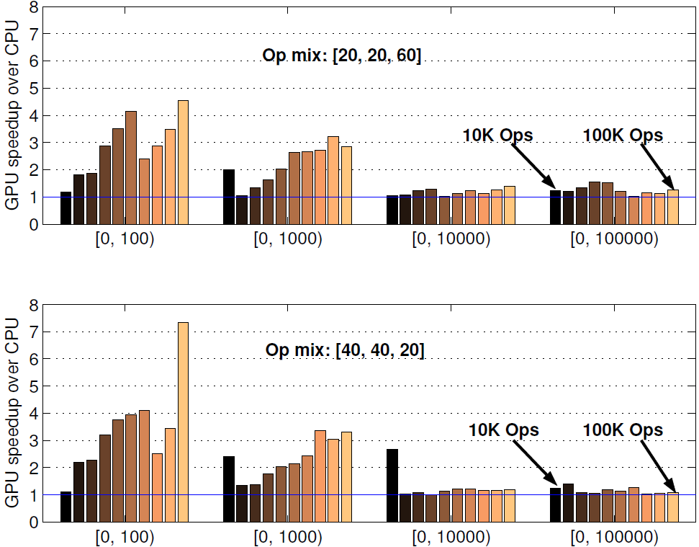
Lock-free linear list
Best performance on small key ranges and larger op counts
Add %
Delete %
Search %
No major difference between search-heavy and add/delete-heavy op strings
Best speedup=7.3

Slide 28
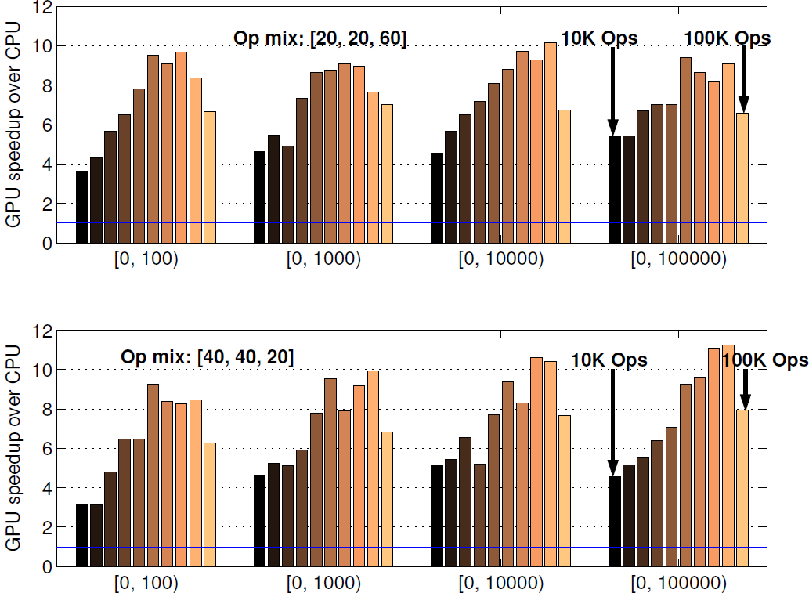
Lock-free hash table
Consistent speedup across all key ranges and op mixes
Best speedup = 11.3

Slide 29
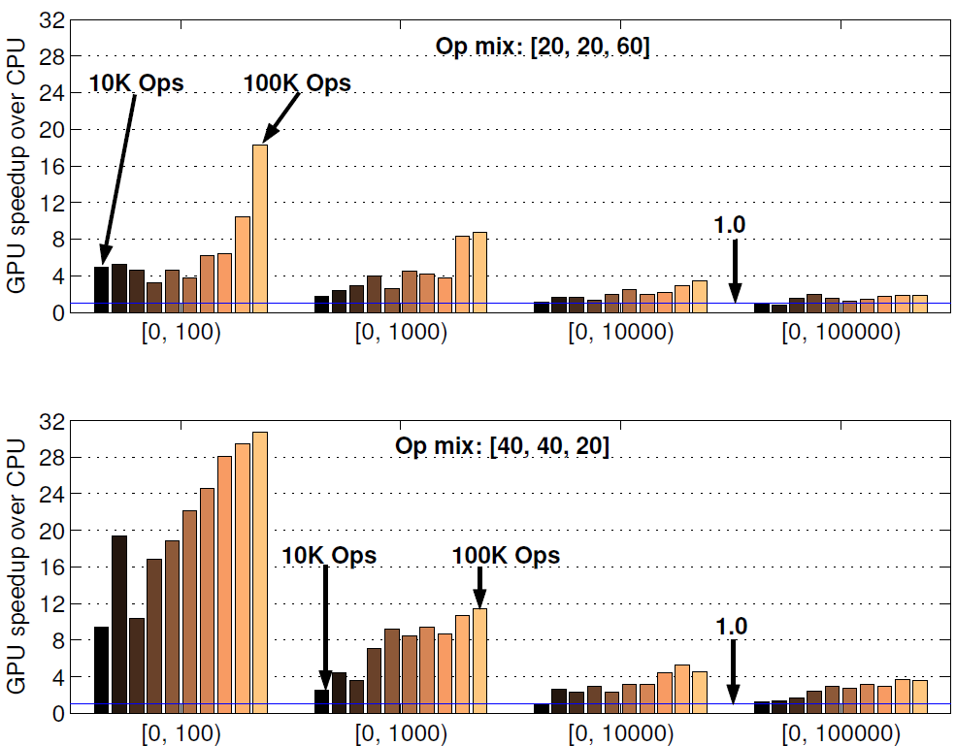
Lock-free skip list
Speedup drops with increasing key range
For identical key range, speedup improves with no. of Add ops
Still good speedup at large key range for Add-heavy op strings
Best speedup=30.7
Around 4x speedup

Slide 30
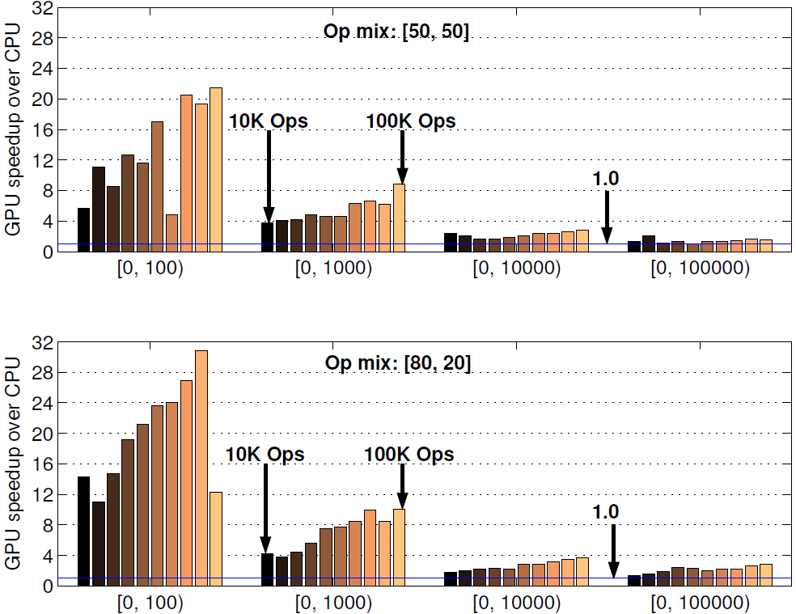
Lock-free priority queue
Add %
DeleteMin %
Trends are similar to skip list: speedup increases with Add %
Best speedup=30.8

Slide 31
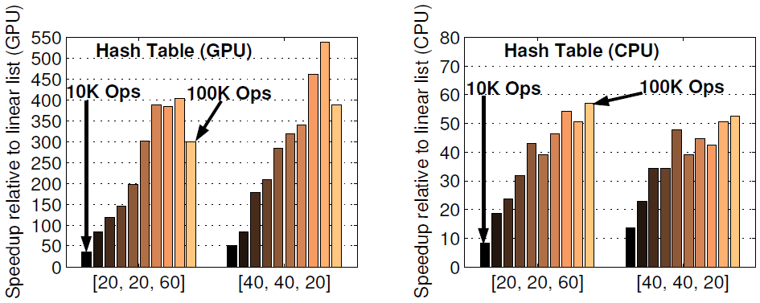
Hash table vs. linear list
The data are shown for the largest key range
On GPU, the hash table is 36x to 538x faster than linear list
On CPU, the hash table is only 8x to 54x faster than linear list
GPU exposes more concurrency in the lock-free hash table

Slide 32
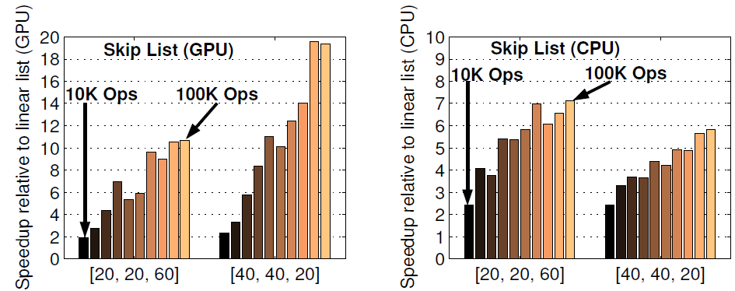
Skip list vs. linear list
On GPU, the skip list is 2x to 20x faster than linear list
GPU still exposes more concurrency than CPU for skip list
Hash table shows far better scalability than skip list

Slide 33
Throughput of hash table
Hash table is the best performing data structure among the four we have evaluated
For the largest key range, on a search-heavy op mix [20, 20, 60], the throughput ranges from 28.6 MOPS to 98.9 MOPS on the GPU
For an add/delete-heavy op mix [40, 40, 20], the throughput range is 20.8 MOPS to 72.0 MOPS
Nearly 100 MOPS on a search-heavy op mix

Slide 34
Sketch
Talk in one slide
Result highlights
Related work
Lock-free data structures
CUDA implementation
Evaluation methodology
Empirical results
Summary

Slide 35
Summary
First detailed evaluation of four lock-free data structures on CUDA-enabled GPU
All four data structures offer moderate to high speedup on small to medium key ranges compared to CPU implementations
Benefits are low for large key ranges in linear lists, skip lists, and priority queues
Primarily due to CAS overhead and complex control flow in skip lists and priority queues
Hash tables offer consistently good speedup on arbitrary key ranges and op mixes
Nearly 100 MOPS throughput for search-heavy op mixes and more than 11x speedup over CPU

Slide 36
Summary
Further improvement requires two key architectural innovations in GPUs
Fast atomics and high synchronization throughput
Helpful for all kinds of scalable implementations
Reduction in control flow divergence overhead
Helpful for complex lock-free constructions such as skip lists and priority queues
http://www.cse.iitk.ac.in/~mainakc/lockfree.html

Slide 37
Thank you

